Slide 1
Country profile: Luxembourg

Slide 2
Why Luxembourg?
Multilingual citizens rather than monolingual regions
High percentage of foreign population and workers
Small, frequently ignored country

Slide 3
What are the main points?
How does Luxembourg manage its language diversity?
What is the role of migrants?
What is the position of Luxembourgish?

Slide 4
Brief History
Used to be larger, but parts of it were annexed by or ceded to other countries until its current “founding” in 1839
Traditionally Catholic
Formed economic union with Belgium in 1922
Some resistance to Nazi occupation
Original member of EU
Movement towards service economy (especially baking) in 1970s
Today Luxembourg is one of the wealthiest nations around

Slide 5
Demographics
39% Foreign residents
% with at least 1 foreign-born parent
39.4% of the workforce are frontaliers, or foreign commuters
Largest share of workforce (33.4% citizens, 27.2% foreign residents)

Slide 6
Language legislation
Luxembourgish introduced into education in 1912
Luxembourgish used in Parliament more and more since WWII
Luxembourgish a citizenship requirement since only 2002
Serious requirement

Slide 7
Language situation
Three official (?) (main) languages: Luxembourgish, French, German
Luxembourgish recognized in 1984 law as national language, and all three are given roles
Laws written in French, French and German are administrative and judicial languages
Who speaks what?
Research has focused on Luxembourgers, but who counts?
Why does this matter for those of us studying LPP?
Non-Luxembourgers rarely speak Luxembourgish as a primary language
French common home language for foreign residents
Most Luxembourgers speak Luxembourgish at home, but many speak French as well
It’s said that German and French are learned as foreign languages only

Slide 8
Problems
Societal multilingualism and individual multilingualism
Ideas about national identity include both monolingualism and trilingualism
Protection of Luxembourgish
Thought of as in danger of becoming a minority language
Migrants rarely speak it

Slide 9
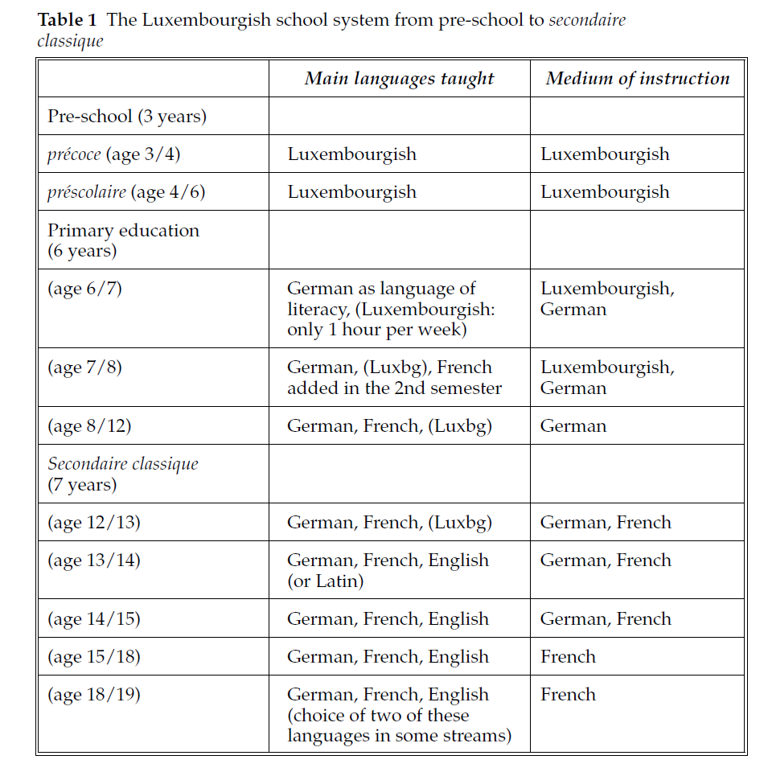

Slide 10
Assumes knowledge of Luxembourgish as children
Romance (e.g. French, Portuguese) speakers tend to struggle in school and frequently do not manage to get into the best high schools
Resistance to accommodation in order to preserve
Luxembourgish not used after elementary school, though many teachers use it to make themselves clear
French and German needed to understand neighbors
Some pressure to add English
Luxembourgish as L2 taught to adults

Slide 11
Job prospects
Luxembourgish, German needed for jobs in public sector
French needed for success in public and private sectors
English needed for success in private sector
German only defended for use in education
Role of English in school

Slide 12
Media multilingualism
Print media dominates
Newspapers, TV shows, movies are frequently multilingual
Papers in particular have long been multilingual, with a majority being in German
French newspapers have recently started to proliferate, with a wider audience
Radio and TV
Mostly state-owned, but some private channels
Luxembourgish dominates, but French and German are also widely present (and occasionally Portuguese too)
French dominates websites
All three languages used in literature

Slide 13
How is Luxembourg different from Belgium and Switzerland? How is it similar?
Are French and German in Luxembourg without being of it? Might any of the three languages be more susceptible to being abandoned?
Should the language policy reworked to accommodate the large foreign presence in the country?

