Slide 1
Non-territorial minorities: The case of the Deaf

Slide 2
Why the Deaf?
Minority present in all countries
Different conception of ‘language’
No written tradition
Thought of as disabled, but self-conception often centers on difference
It’s not that deaf people can’t hear, it’s that they don’t hear

Slide 3
Main points
How do the Deaf resemble other language minorities? How do they differ?
How does the “disability” construction undermine or advance the Deaf’s language rights?
What is Deaf education like?

Slide 4
Some basic facts
There exist many different sign languages, just as there exist many different spoken languages
Technology like hearing aides and cochlear implants are divisive
Some welcome the chance to hear
Others see it as an assault on culture, even a cultural genocide, an attempt to deprive a people of their language in the name of “medicine”
Many Deaf people perceive a great deal of “audism”, prejudice against people based on their ability to hear, even within own families

Slide 5
History
Many debates about the intelligence and morality of Deaf people
Attempts to ban signs have been commonplace from at least the 1600s
In mid-1700s, Abbé de l’Épée was among the first to recognize the systematicity of deaf signs and use it to develop a full language
In the 20th century, sign languages have been recognized as languages like any other and many have been declared official minority languages

Slide 6
The case of France

Slide 7
Statistics
7% of French deaf or hard of hearing (60% of whom are senior citizens)
80% illiteracy rate vs. 5% with some college
750 out of 11,000 deaf institutes are run by the state
106 deaf students accepted to college in 1992; 218 in 1993
Deafness treated as handicap (Gillot 1998)
2005: Right to bilingual education

Slide 8
Methods of instruction
Oralism vs. Total communication
Language of instruction: French, French Sign Language, Signed French, Cued Speech
Possible emphases: bilingual competence sign/writing, lip-reading & articulation, sign-language only, content regardless of language
What would be the rationale for any of these?
Goals of education: Mainstreaming, anti-communitarianism, preservation of Deaf culture

Slide 9
Foreign languages
Local and global integration: at odds?
I.e. should we teach foreign languages to the Deaf?
Object of instruction: Written language, sign language, lip-reading, articulation
When written and sign languages don’t match up 1:1: The case of English, ASL, ISL, & BSL

Slide 10
Instructor formation
Hearing vs. Deaf instructors in public and private schools
Extensive use of interpreters in the classroom
Cost of expansion of services: demand far exceeds supply
High illiteracy rate among deaf
Low number of hearing LSF speakers

Slide 11
French Educational and Social Goals
Equality of opportunity for all students
Non-recognition of minorities
High reasoning skills
Ability to compete in a globalized and globalizing society
How much time should be spent teaching speech vs. content?

Slide 12
Rest of Europe

Slide 13
EU
Asked all its member countries to recognize sign languages in 1988 and again in 1998
Iceland
Formerly sent deaf to Denmark
Some education rights as L1
Ireland
High illiteracy rate
Gives some literacy education to adults
Not official minority language
Britain
Some interpreter rights (justified by handicap)
No legal protections like Welsh etc.

Slide 14
Spain
Some dialectal differences in Catalonia and Valencia
Legally recognized since 2007 (in 1994 within Catalonia, 1998 in Andalusia, and 2006 in Valencia), with a justification that it’s the result of a handicap
Portugal
One of two minority languages recognized (1997)
Italy
Provides some interpreter rights, but little else

Slide 15
Belgium
Recognized within Wallonia (2003) and Flanders (2006)
Different sign languages in the different regions
The Netherlands
No recognition, in part because it is seen as unconstitutional
Limited hours of interpretation
Denmark
No recognition yet, despite marches
Norway
Some use in media
Some recognition coming
Sweden
Teaches Finnish-Swedish Sign Language as an L2
Gives no protection to it as minority language

Slide 16
Germany
Strong history of suppression
Free use of interpreters
Recognized in a disability act
1 TV program every Saturday morning
Switzerland
Deaf communities line up with speaking communities
Some rights based on disability
86 interpreters
Austria
Recognized since 2005
Only minority language recognized

Slide 17
Luxembourg
No legal recognition
1 interpreter
Malta
No legal recognition, nor attempts
1 interpreter
Education done with other disabled students
Liechtenstein, San Marino, Andorra
No legal recognition or assistance
Greece
Legally recognized as language of Deaf
Teachers do not know GSL

Slide 18
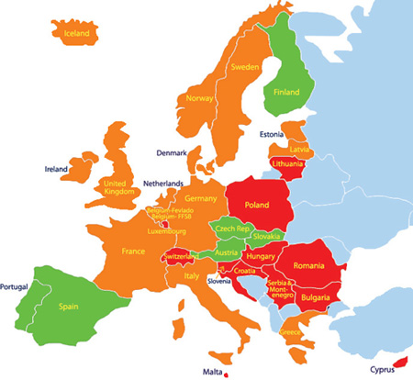
Summary

Slide 19
Discussion question
Does being perceived as needing language rights due to a handicap help or hurt the Deaf? Other language minorities?

