Slide 1
Demonstrative-blocking in complex DPs in Guianese French Creole
Jason F. Siegel
6th Annual IULC/Linguistics Dept. Conference
April 13, 2012

Slide 2
Overview
Language landscape of French Guiana
Structure of DP in Guianese and other French-based creoles (FBCs)
Blocked and unblocked demonstratives in complex DPs
Conclusion

Slide 3
Language landscape
Official language: French
11 regional languages:
Guianese French Creole (!)
English-based creoles: Saramaccan, Aluku, Ndyuka, Paramaka
Amerindian languages: Kali’na, Wayana, Palikur, Wayampi, Emerillon
Hmong
Immigrant languages: Mandarin, Brazilian Portuguese, Javanese
All French Caribbean Creoles (Haitian, Guadeloupean, Martinican, St. Lucian, historically Dominican) except Louisiana

Slide 4
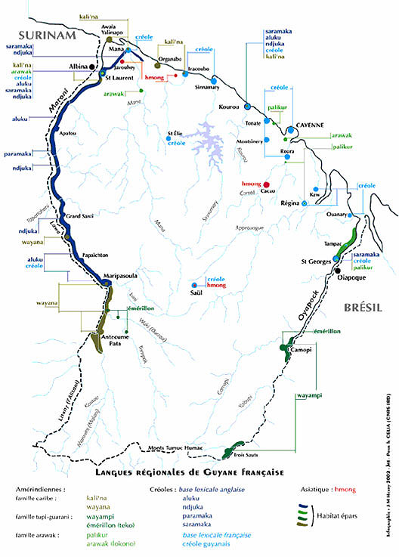
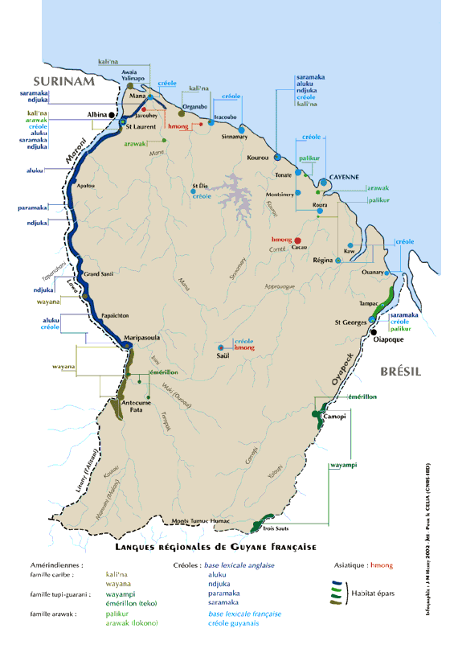

Slide 5
Structure of simple DP in Guianese
No bound inflectional morphology on N
Un-determined nouns can be singular or plural, mass or count (1)
Indefinite, possessive, and demonstrative determiners all precede N
Definite determiner DP-final (2)
Note that in demonstratives (2g) the demonstrative and definite determiner are both obligatory
DPs can be expanded in certain ways without changing patterns of determination (3), but in complex DPs (4-7) things change

Slide 6
Structure of simple DP in FBCs
Déprez (2007): Variation in determiner positions among FBCs can be explained through appeals to movement within a highly specified architecture
Some creoles have only pre-nominal determiners, some pre- and post-, but none only post-nominal (indefinite article always pre-)
Variation motivated by a principle to always fill Spec of functional heads

Slide 7
Structure of simple DP in FBCs
DP
(la) D’
la DemP
(sa) Dem’
(sa) NumP
(Pl) Num’
NP

Slide 8
Structure of simple DP in Guianese
DP
D’
a DemP
Dem’
NumP
Num’
NP
sa
y
famn

Slide 9
Structure of simple DP in Guianese
DP
D’
a DemP
Dem’
NumP
Num’
NP
sa
fanm
y

Slide 10
Demonstrative blocking
In complex DPs, there is an unexpected development: the demonstrative determiner sa is blocked
Consider the genitive structure, with surface structure N N (Det)
Sa cannot appear DP-initially, as it does in simple DPs (10)

Slide 11
Why is it blocked?
Lumsden (1989): in Haitian complex DPs, only one definite determiner surfaces (12)
Same generalization holds true for Guianese (13)
Two DP-final definite determiners not permitted (14-15)
Only most embedded determiner (16)
Following Abney (1987), Lumsden proposes a null determiner in the matrix DP

Slide 12
Haitian genitive
DP
D′ DP
NP D D′ | ø
N′ [genitive] NP D | | yo N N′ jwèt | N timoun
Lumsden 1989: 79

Slide 13
Same restrictions in Guianese
Proposal: demonstrative sa must be immediately dominated by the definite determiner a (17)
Notice that surface explanations cannot account for this restriction

Slide 14
DP
D’
a DemP
Dem’
NumP
Num’
NP
sa
y
fanm

Slide 15
Without a definite determiner from the matrix DP, sa does not surface
Explains ungrammaticality of initial sa in not just genitive, but other complex DPs as well
Why not a second determiner?
Lumsden (1989) proposes a processing constraint against the same functional morpheme appearing immediately after the same functional morpheme (18)

Slide 16
Sé: a curious puzzle
Said to come from Antillean creoles, where it is a pre-nominal plural marker
Ultimately, comes from French plural demonstrative ces
Plural demonstrative only
In complex DPs where sa is disallowed, sé is accepted as a repair (19)
Cannot appear without ya at the end of the DP (20), but does not need to be dominated by a
Antillean plural marker sé appears obligatorily with singular definite determiner (21)

Slide 17
Sé has a semantic, not syntactic, requirement to appear with ya
Must appear with plural marker, not with definite article
Compare to possessive structures, where plural interpretations are strongly dispreferred without the plural marker (22)

Slide 18
Another etymology
Given different syntactic restrictions and semantic functions, might not have come from Antillean
Could be borrowed directly from French
Same demonstrative function
Never appears with the singular definite article
Fission of syntactic feature bundle of [+plural, +demonstrative]

Slide 19
Conclusion
Déprez (2007) allows us to explain why sa does not occur in complex DPs
Sa must be immediately dominated by definite article a
Only possible in this highly specified architecture
Sé, a plural demonstrative, shows different properties from both sa and Antillean sé
May be a French borrowing

Slide 20
Future directions
PossP
Other dialects, other FBCs

Slide 21
Thank you!

